Slide 1
Is Now a Good Time to Buy a Home? By: Justin Froehlich, Pablo Samuel Reyes, Laura Herrera-Perafan, Jesse Swincicki, Hector Garcia

Slide 2
Hypothesis
Given historical data and current trends, is buying a house right now a bad idea?.

Slide 3
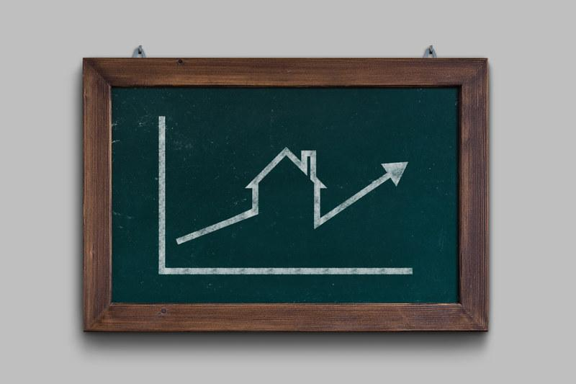
Introduction
Our project’s focus is to determine whether purchasing a home in today’s market is a good idea or not, specifically in the state of Florida.
Is the consumer purchasing property for its intrinsic value or for other reasons such as family life?
We collected data from sites such as Fred, Census Data, and Realtors to analyze the current and previous markets and test our hypothesis.
We also used APIs such as Zillow and FRED through directly downloaded CSV files.
We used Jupyter Notebook to clean, drop, rename, graph/plot, and export visuals.
Notes:
Good idea is based on if the person buying the home wants to create memories and being family oriented vs purchasing a home for its intrinsic value meaning not losing any of the downpayment due to a market correction.
COVID affecting the current market

Slide 4
Key Principal Indicators
Listing Inventory
Listing Prices
Key Metrics
Personal Consumption Expenditure (PCE)
Unemployment Rates
Price to Rent Ratio
Historical Home Market Values

Slide 5
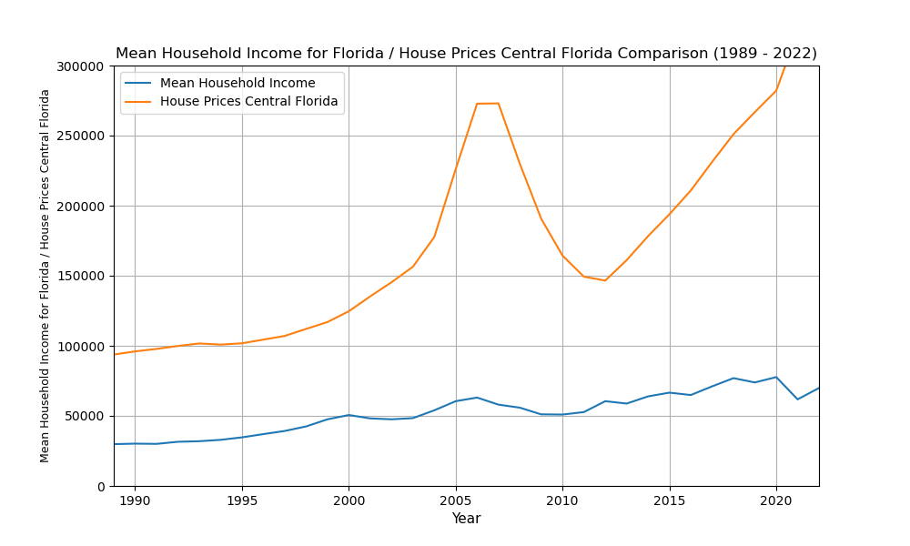
Is the housing price index keeping up with the rate at which peoples wages are increasing?
This data set is from 1989 to 2022 and shows housing price and median household income
The trend shows that household income is not keeping up with housing but is increasing

Slide 6
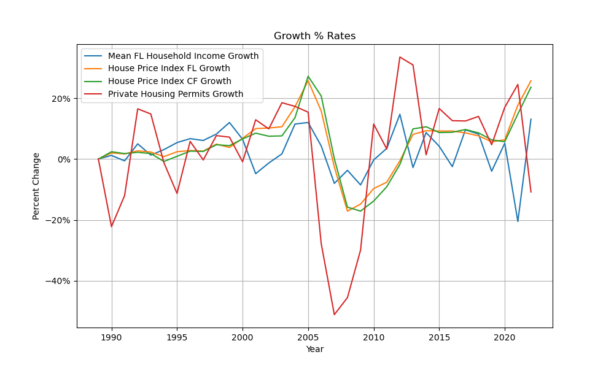
2008 Recession vs. Today
We can see that the number of private housing permits drastically fell in the 2007-2008 range.
In 2021, permits began declining again, hitting its lowest number since 2010 in 2023.
A major difference however is the other metrics on this graph are currently increasing post-pandemic.
Household income is still recovering from the pandemic, though the steady increase could be a good sign if the House Price Index can flatten out.

Slide 7
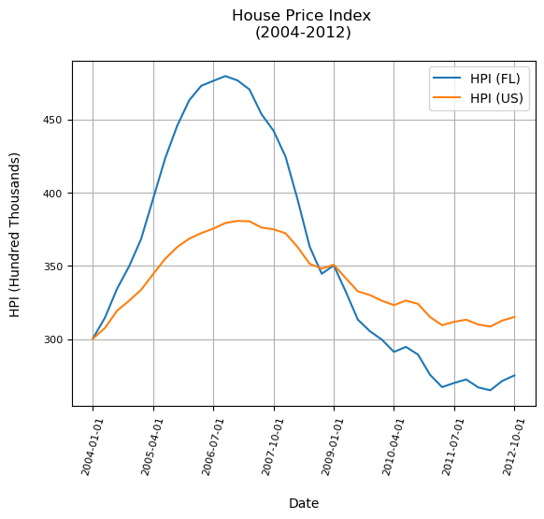
Trends throughout Recession
The House Price Index is a statistic recording the overall movement of single-family house prices. It is used to analyze house prices and estimate mortgage defaults and affordability.
The market crash of 2007 demonstrates a significant drop in overall HPI values.
This data supports the fact that after the housing market crash, homeowners found the values of their homes dropping well below the amount of money they borrowed to finance the property.
As a result, homeowners who purchased property prior to the crash suffered great economic losses.
Although HPI tracked highest at 2006 after the crash, housing values still took six years to recover.

Slide 8
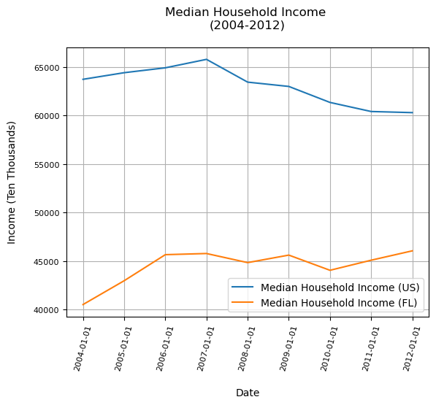
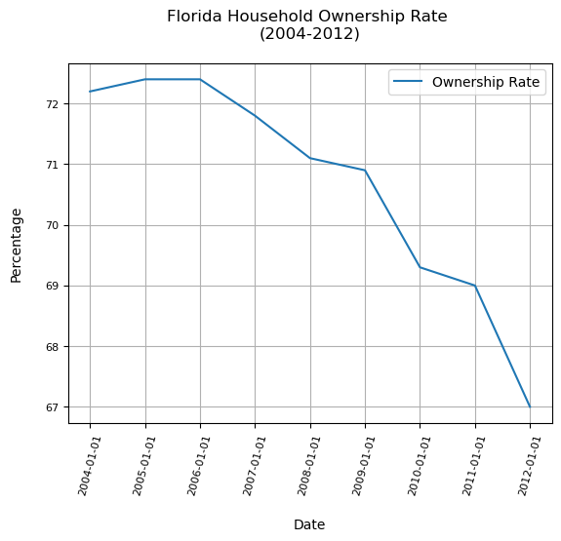
Although MHI remained consistent after the market crash, ownership of houses dropped following the recession’s onset.
Notes:
One of the reasons why the ownership rate began to drop significantly on 2006 to 2012 was because of the flexible interest rate on the mortgages. Once the market began to change it in turn affected the mortgage payments of the individuals holding such flexible rate policies.

Slide 9
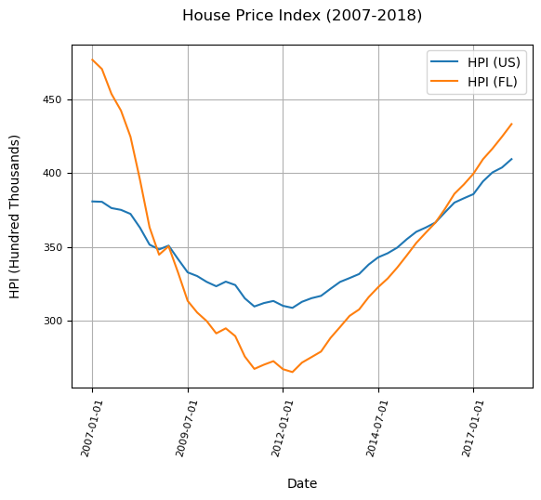
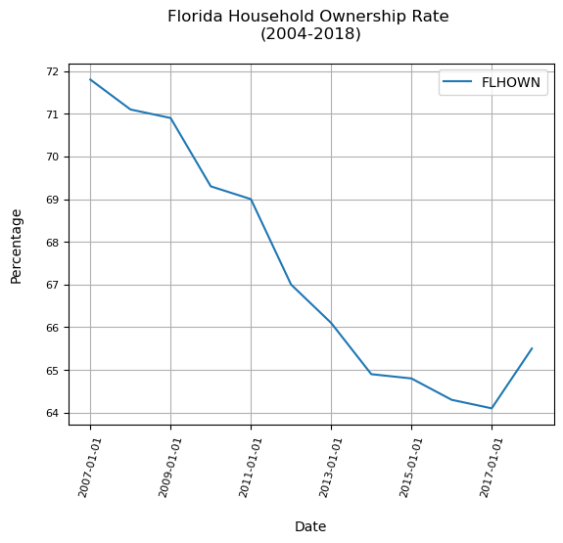
Following the crash, HPI values took nearly a decade to recover.
We can observe that house ownership did not follow in this recovery.
Notes:
The first figure shows that Florida was hit much harder than the national average. This is because Florida is a very desirable state for notherns to move for the weather. It also shows that it recuperated much faster than the national average because after 2016 florida appreciation values for homes began to increase faster than the national average.

Slide 10
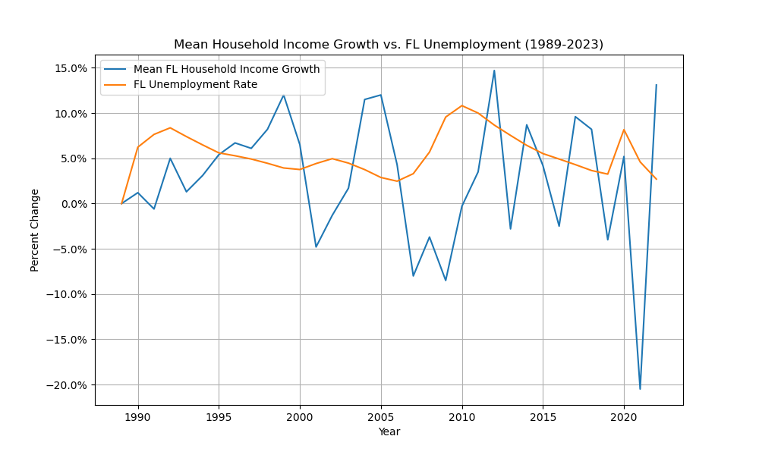
Unemployment Rates during Recession
Here we have 3 instances where the Mean Household Income were impacted the most: 2001, 2006 - 2008, and 2020.
These are the dot com recession, the 2008 recession and the impact caused by COVID.
We can also see the the unemployment ratio dips for the dot com and the 2008 recession right after the recession which means that unemployment is delayed slightly from recessions.
For this reason, it's hard to use unemployment as a means to identify or predict any suspicious recessions.
Notes:
This graph shows 3 instances where the Mean Household Income were impacted the most: 2001, 2006 - 2008, and 2020. These 3 instances are the dot com recession, the 2008 recession and the impact caused by COVID. Also, we can see that the unemployment ratio for the dot com and the 2008 recession happens to take place right after the recession which means that unemployment is delayed slightly from recessions. For this reason, it's hard to use unemployment as a means to identify or predict any suspicious recessions.

Slide 11
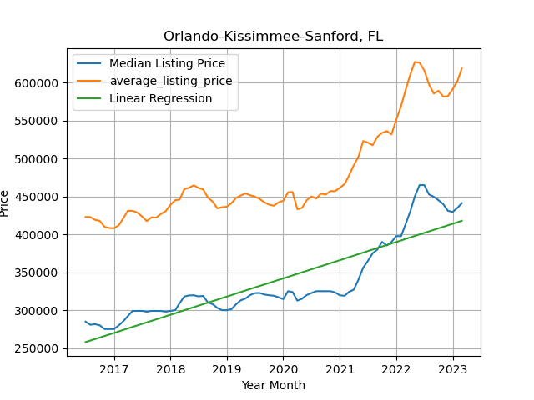
Median vs. Average Listing Price
(Central Florida)
Within the last year, we can see the median and average listing prices in Central Florida took a significant spike.
There is a strong correlation between the average and the median listing prices.
Therefore, the regression line is applicable to both lines almost in the same fashion.
Disregarding the spike in 2022, the regression line would appear much flatter.
Because of this spike, we can draw a conclusion that there are many other factors affecting these listing prices.
The behavior from 2021-present is a behavior similar to the one we saw in the first graph from 2004-2006.

Slide 12
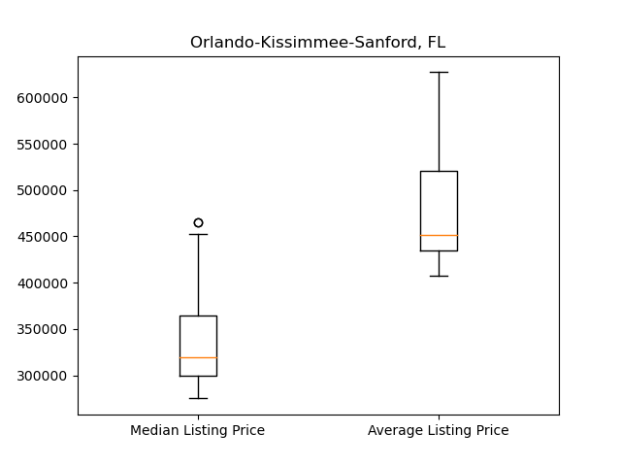
Box Plot of Realtor.com Data (Median/Average Listing Price)
Notes:
The median shows one outlier for Median Listing Price of $460K.

Slide 13
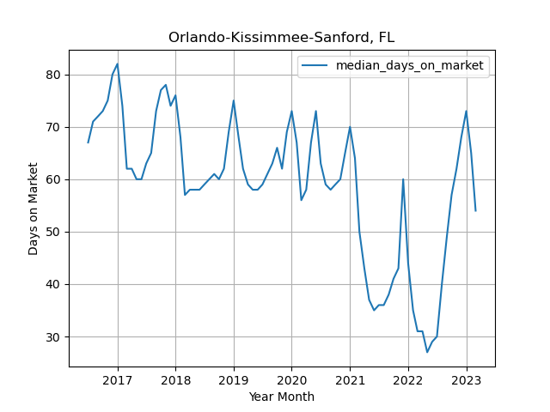
Median Days on Market (Central Florida)
We can see here that beginning in 2021, in the middle of the COVID pandemic, houses were selling about twice as fast as they were in years prior.
There was an interest rate hike in June of 2022 which would explain the rise in days on the market in that year.
June of 2022 also showed the highest inflation rates in the last 10 years, proving that there is a correlation between inflation rates and days on the market.
We believe the downtick of 2023 is being caused by inflation rates in January slightly decreasing, Homebuyers may think the situation is improving when in reality it isn’t
Notes:
***********need inflation chart

Slide 14
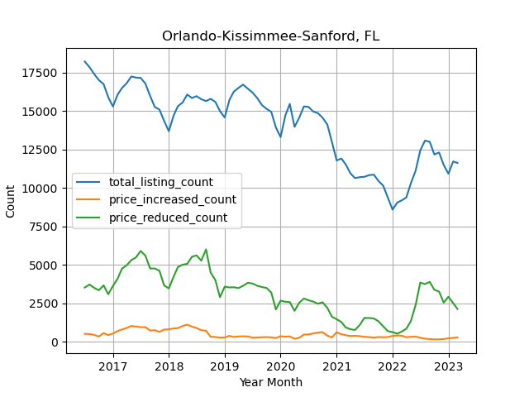
Listing Counts of Homes in Central Florida
The amount of homes that sell above their original listing prices historically stays
about the same
The amount of homes that sell below their original listing prices appears to be directly correlated with the total listing count of all homes.
From this, we can determine that a majority of homes are either being listed at prices higher than their value, and that prices need to be dropped due to buyer ability or number of purchasers
Customer sentiment effect

Slide 15
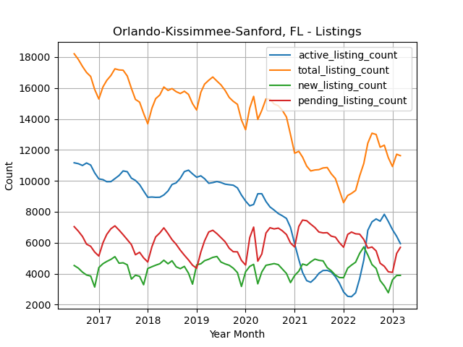
Listing Counts of Homes in Central Florida (cont.)
Correlation between active and total listing count.
Correlation between new and pending listing count.

Slide 16
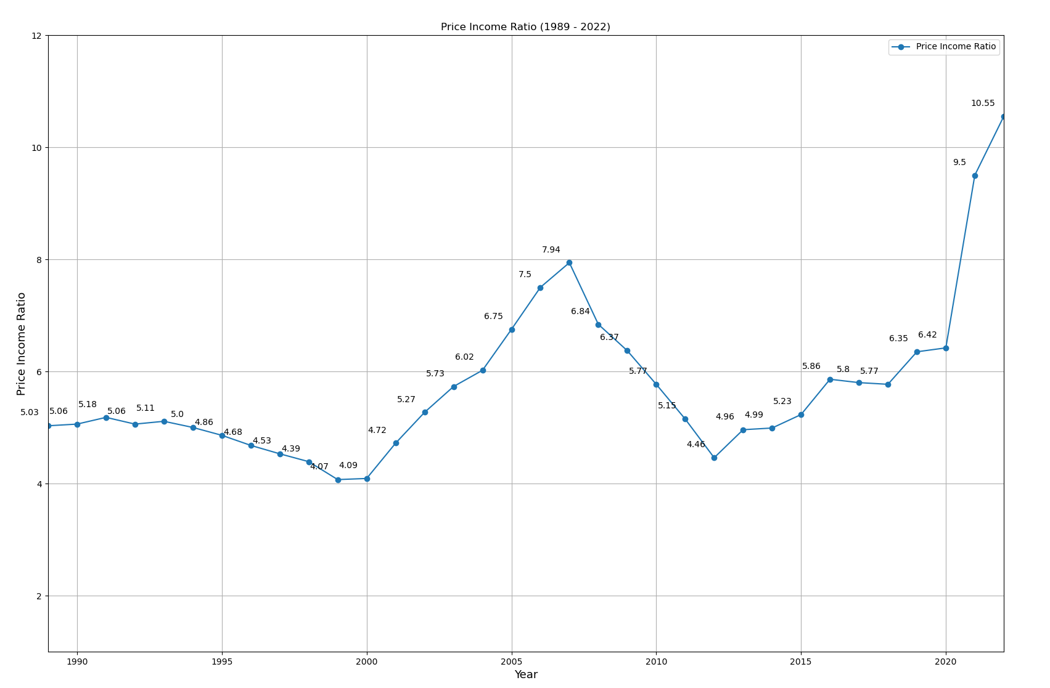
Home Price to Income Ratio (1989-2022)
Home Price to Income Ratio is a value that compares your annual household income and the price of the home to determine affordability.
In 2020, we surpassed the highest ratio since 2008, and are currently at the highest peak since the 1980’s.
At the current ratio, your household income would need to be double what is was in 2018 to afford the same level home as that year.
There is no sign or evidence that household income has duplicated in any states in the past 10 years.
This chart clearly implies that there needs to be a correction to the affordability of homes.

Slide 17
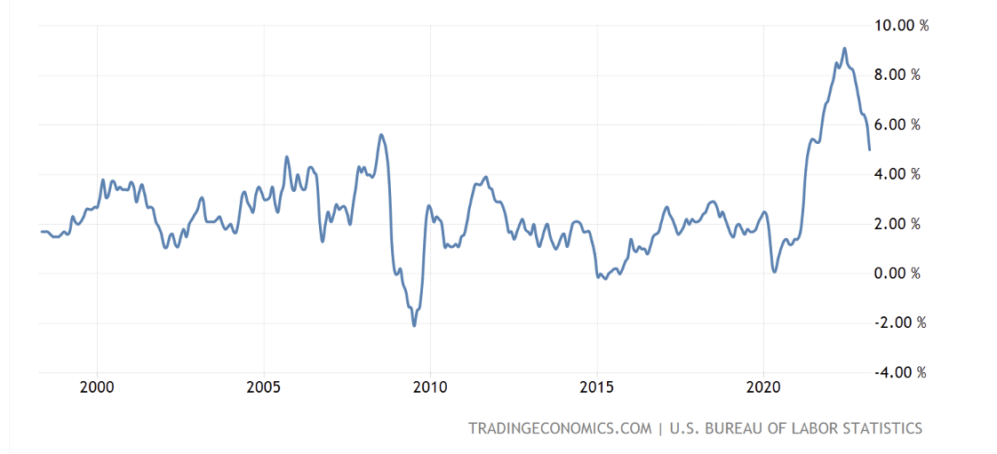
Inflation rate chart
Notes:
Would be great to add this line to the graph on slide 16. There appears to be correlation between the national inflation rates and the Price Income Ratio.
This graph is showing that inflation is coming down but the price income ratio is not. It may be lagging behind the inflation rates.
Inflation rates seem to come down when people lose jobs.

Slide 18
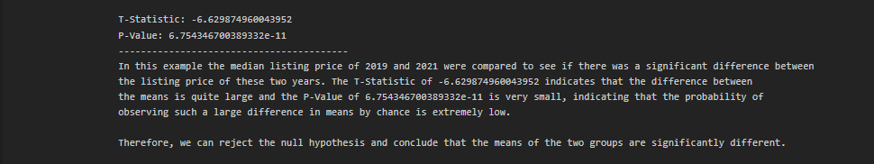
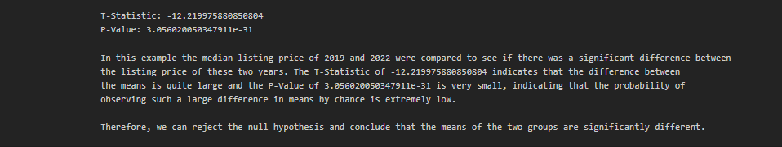
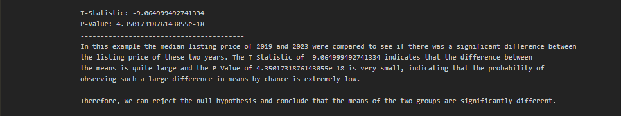
Null Hypothesis is that there isn’t any difference in buying in 2019 to >2019.

Slide 19
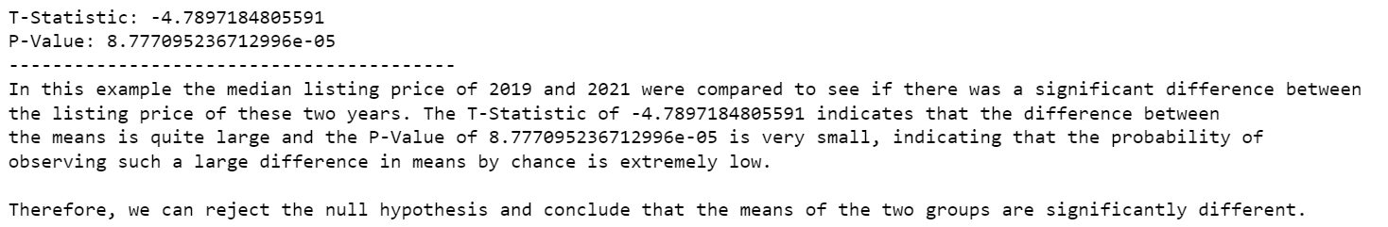
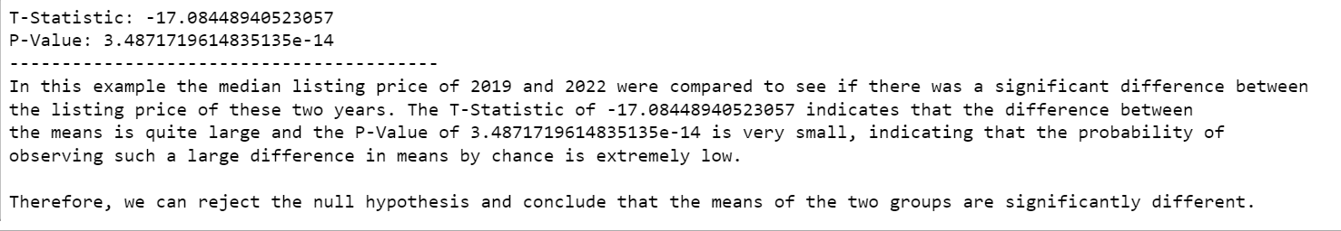
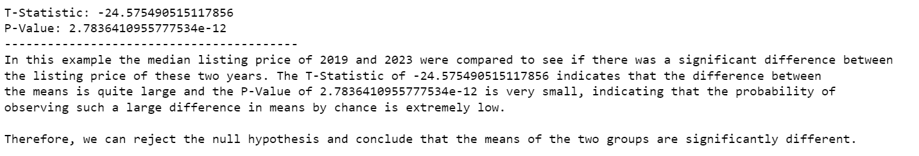
P-Value for Orlando, Kissimmee, and Sanford

Slide 20
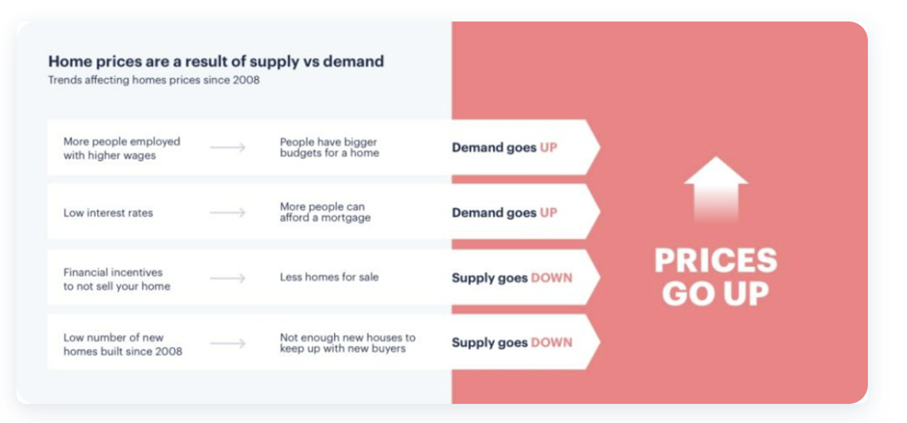

Slide 21
Thank You

